Slide 1
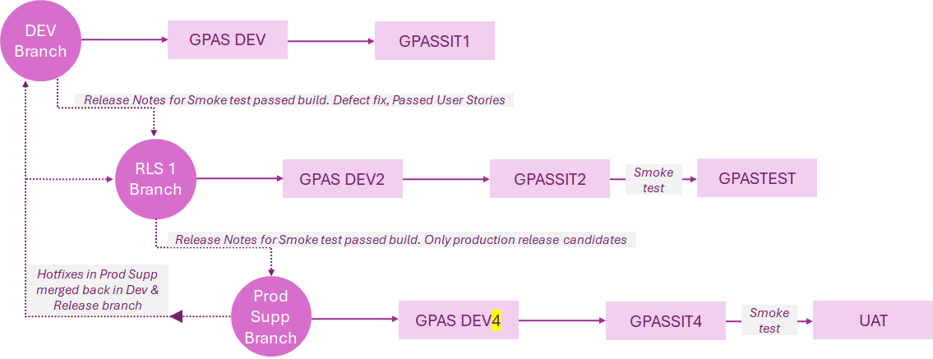
GPAS – Guidewire code and environment management
Another branch incl. Dev & SIT env for Small, Med changes to be deployed to Prod between major releases
Integrations | GPASSIT1 | GPASTEST | GPASIT4 | GPASSIT2 | UAT
Documents | Precisely | Precisely | Precisely | Precisely | Precisely
InSight | usdvws018:9001 | usdvws020:9001 | usdvws018:9001 | usdvws018:9001 | usdvws020:9001
CRM | Dev | Sys | Dev | Dev | Sys
MDM | Dev | Pre-Prod | Dev | Dev | Pre-Prod
UW Controls | Dev | Sys | Dev | Dev | Sys
CDA |  |  | N/A | N/A | N/A
BI | N/A | SYS | N/A | N/A | N/A
CededRI | N/A | SYS | N/A | N/A | N/A
Exp Mgt | N/A | SYS | N/A | N/A | N/A
Agresso | N/A | UAT | N/A | N/A | N/A
GetPaid | N/A | UAT | N/A | N/A | N/A
Integration setup to be completed for
GPASSIT4
GPASSIT2
UAT

Slide 2
GPAS – Guidewire code and environment management
DEV Branch
Sprint – Time travel Environment Will primarily used for Sprint Testing (Can be shared for any Release Testing)
GPAS DEV
GPASSIT1
GPASSIT3
Release Notes for Smoke test passed build. Defect fix, Passed User Stories
RLS 1 Branch
GPAS DEV2
GPASSIT2
Smoke test
GPASTEST
Release Notes for Smoke test passed build. Only production release candidates
Hotfixes in Prod Supp merged back in Dev & Release branch
Prod Supp
Branch
GPAS DEV4
GPASSIT4
Smoke test
UAT
CR/Medium/Low Priority Issues/ Continuous Release/BAU
Monthly Release
GPAS DEV4
GPASSIT5
Smoke test
UAT

Slide 3
GPAS – Guidewire Branching Strategy - Environments
Master (Production)
GPASSIT4
After deployed to Production
Cascade back to Next planned Release
Develop (Default)
GPASSIT1
Continuous Development of multiple Release/ features
Cascade Merge
Cascade Merge
Release Branch Cutover
Cascade Merge
Production Release complete
Release-N
GPASSIT2 -> GPASTEST
Cascade Merge
User branch PR Merge (fixes/features)
User branch PR Merge (fixes/features)
User branch PR Merge (fixes/features)
Current Planned Release
Production Release complete
Release Branch Cutover
Cascade Merge
Cascade Merge
Cascade Merge
Release-N+1
GPASSIT1 / GPASSIT5
User branch PR Merge (fixes/features)
User branch PR Merge (fixes/features)
User branch PR Merge (fixes/features)
Next Planned Release
Production Release complete
Hotfix Cutover
Hotfix
GPASSIT4
Adhoc Fixes (Urgent Issues)

